Slide 1
Project Demo
Presented by Angry Nerds Team: Richard, Marcus, Ly, Paula, Jose, and Ahmed
Notes:
For Marcus:

Slide 2
Our Team
Ly: Project Manager
Richard: Backend Technology Lead
Paula: Backend Developer
Ahmed: Frontend Technology Lead
Reporting: Marcus & Ly
Testing: Richard & Jose
Notes:
Everyone: Introduce yourself

Slide 3
How do we communicate?
Discord
Google Docs
GitHub Repo
Meetings:
After Class
In Library
Over Discord
Notes:
For Ly

Slide 4
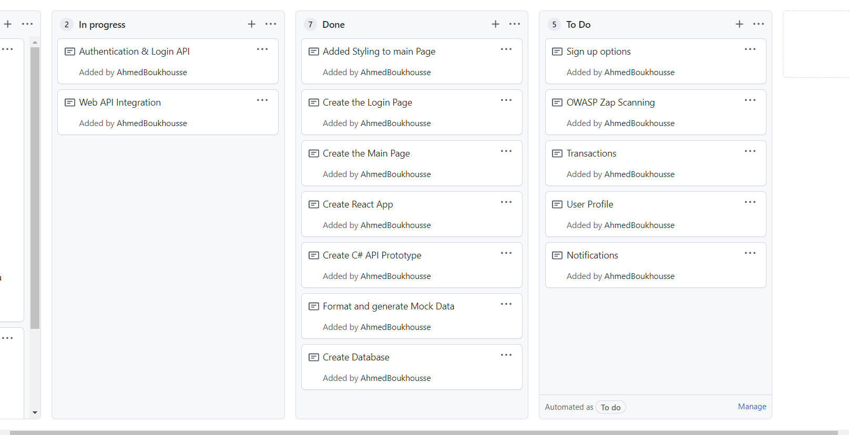
Project on GitHub
Notes:
For Ahmed:
This is a screenshot illustrating how we have been organizing our work on GitHub. We needed it to keep track of our progress.

Slide 5
Technologies used (Backend)
Backend
MySQL Database (Storage)
C# ASP.NET Core (API)
IIS Express (Development Server)
Notes:
Richard's Slide

Slide 6
Technologies used (Frontend)
Frontend
Node.JS (Language)
React (JS Framework)
React-Scripts (Dev) and Node.JS Express (Prod) (Servers)
Notes:
For Ahmed

Slide 7
Technologies used (Frontend)
React router dom
Styled-components
React scroll
React icons
Notes:
For Ahmed:
router : switching between pages
Styled components: Utilising tagged template literals (a recent addition to JavaScript) and the power of CSS, styled-components allows you to write actual CSS code to style your components

Slide 8
Testing Phase
Items Tested
login via username and password onto their online banking account
View of their transactions’ history
set triggers for notification rules
receive notifications based on triggers previously set
for the system to store users data to the database
Notes:
During our testing phase we focused our testing routine to test the Online Banking system’s ability to allow customers to login to an online banking system and see their transactions’ history. We also tested the ability for users to set triggers for notification rules and receive notifications around them. The system’s capability to save data to a database was tested as well. The results of these testing procedure enable us the creators of this system to gauge project success.

Slide 9
Technologies used (Testing)
Testing
Python (Simple)
Requests (Library to Test API)
Selenium (Library to Test Frontend)
Notes:
The overall method of this testing procedure was mainly manual system testing. Test cases that include similar Feature methods were tested together. Examples of those features were logging in to view transactions, logging in to set notifications and/or logging in to view set notifications. Test cases such as those tested the security features of the system along with the ability to query information from the database. Each test case tested the security feature with invalid and valid data such as usernames and passwords, to ensure that user requirement of valid users for these features is met.
The main technology used for testing was pythons own testing suites and future iterations will have selenium to automate frontend testing.

Slide 10
Architecture
Database stores all user, account, and transaction information
Backend enforces security and controls access patterns
API handles all requests for Frontend
Done to ensure secure requests and access
Helps format data for consumption
Is testable
Frontend displays information to users
Notes:
For Marcus

Slide 11
Architecture (Continued)
Example: Login (Happy Path)
On sign in page, the user will type their email and password into the form.
Upon submit of the form, a javascript function is called, which then takes the form data and posts it to the getToken API endpoint.
The API searches the database for user salt and hash based on the email
If the user exists the submitted password is merged with the salt from the DB and hashed.
If both hashes match, a token is returned to the client.
The client then stores the token in local storage and redirects the user
Notes:
For Paula

Slide 12
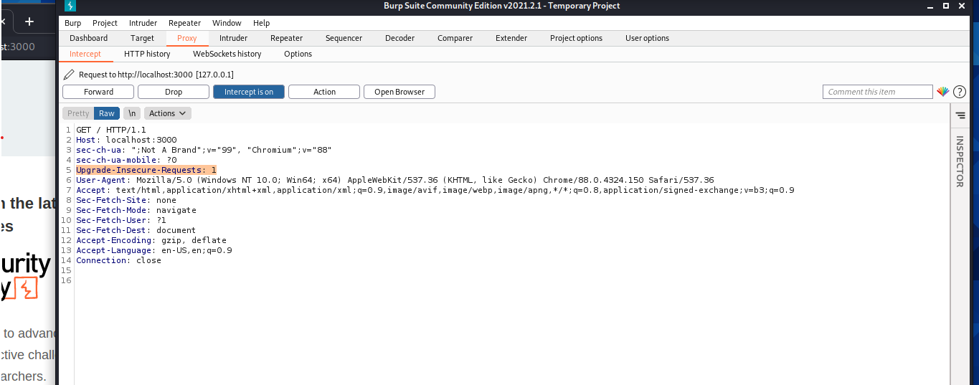
Using Burp Suite
Notes:
For Ahmed:
The HTTP Content-Security-Policy (CSP) upgrade-insecure-requests directive instructs user agents to treat all of a site's insecure URLs (those served over HTTP) as though they have been replaced with secure URLs (those served over HTTPS). The upgrade-insecure-requests directive will not ensure that users visiting your site via links on third-party sites will be upgraded to HTTPS for the top-level navigation and thus does not replace the Strict-Transport-Security (HSTS) header, which should still be set with an appropriate max-age to ensure that users are not subject to SSL stripping attacks.

Slide 13
Team Struggles:
Learning new technologies
The team are not familiar with most of the technologies used ( React, Python … ext)
Scheduling conflicts
Most of the team members are working full time
Given the size of the team, it has been difficult to organize meetings
Agile methodology was not fully used.
Scrum methods were not followed.
Notes:
For Ly

Slide 14
Team Progress
Gathering requirements
Technical Learning
Setup of Development Env.
End-to-End (Vertical) Prototype
Notes:
For Jose

Slide 15
Link to the project GitHub
https://github.com/UMKC-CS451R/cs415r_f21_groupproject-angry-nerds

